Slide 1
Lorentz Angle Measurement
8/23/11

Slide 2
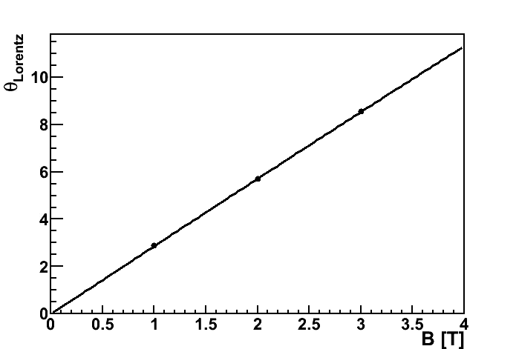
Result
Line is theory, θ = arctan(v_{d} B/E)
Points are measurements

Slide 3
Method
s₀
Without B
d
s₁
With B
s₁ = s₀ + d tanθ_{L}

Slide 4
Method
Pixels in the middle contribute their entire pitch to s
…
Need for figure out how far charge traveled in edge pixels
Need to measure s as a function of B
Distance in edge pixels call d_{L} and d_{R} (left and right)
Distance in central pixels call d₀
Then s = d₀ + d_{L} + d_{R}
d₀ = maxY – minY – 1
d_{L} ? d_{R} ?

Slide 5
Finding Edge Distance
Can use charge deposit as an average measure of distance
d_{edge} = (Q_{pix}/η)
η: Expected charge deposit for traveling a distance d. (for us, η = 36/sin(20))
Q_{pix}: Charge deposited in pixel
So we turn a charge deposit into a distance that we know the track had to travel in order to deposit the amount of charge it deposited

Slide 6

Plot of s = d₀ + d_{L} + d_{R}
Close, but not quite
Some corrections need to be made first

Slide 7
Correction 1: 36 e/μm is not quite right
For whatever reason, we don’t get the magical 36 value in our data
Could be gain cal, could be actual different yield with this diamond, hard to say
We can measure it though, by taking the sum of all the charge in all clusters, averaging it, and accounting for the rotation’s increase in charge
Get something more like 38

Slide 8
Correction 2: Charge loss
Clearly the slope of the data points are wrong since it needs to point to 0
This means that more charge is being lost (which is in turn interpreted as a shorter s) at higher B fields
Make sense, since the charge is spread out more
2 sources of charge loss:
Leaking into neighboring pixels in X when close to boundary
A final or initial pixel would have been lit up but was below threshold

Slide 9
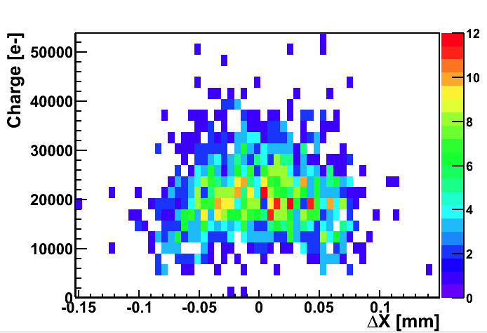
Correction to Charge Loss By Leakage into X
Made cut that the track needs to stay away from the border

Slide 10
Correction to Charge Loss Due to Missing Edge Pixels
Did this statistically
Need probability that a given event will have a missing pixel at beginning or end due to threshold effect
I.e., “What is the probability that charge Q is below a given pixel’s threshold”
Untrimmed thresholds are Gaussian around 5500 with a spread of ~1500 (see Karen’s talk)
P = Φ(Qtot/Nhits-5000, μ=5000,σ=1500)
Φ is cumulative distribution function for Gaussian, i.e, Erfc
Add Φ*5000*2 (2 because I need to account for each edge) charge to each event’s charge
Basically 0 for one hit and 2 hit events, becomes significant for 3 and 4 hit events (Qtot/N gets closer to threshold)

Slide 11
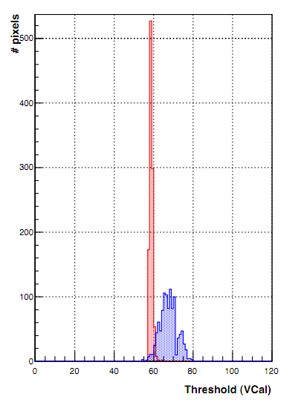
From Karen’s Talk

Slide 12
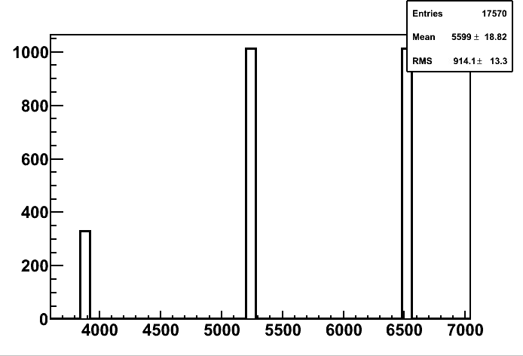
Also measured by looking at coarse S-curve (from gaincal results)

Slide 13
Correction 3: Border Rows and Columns, Noisy Pixels, etc.
Mask the usual columns + a few for purity
minX[1] > 15 && maxX[1] <35 && minY[1] > 42 && maxY[1] < 78
Noisy Pixels were removed
Noisy Strips were removed
Bad gaincal fits were removed
Cluster topology: No dimension in X (ensured by aforementioned residual cut)

Slide 14
After applying corrections

Slide 15
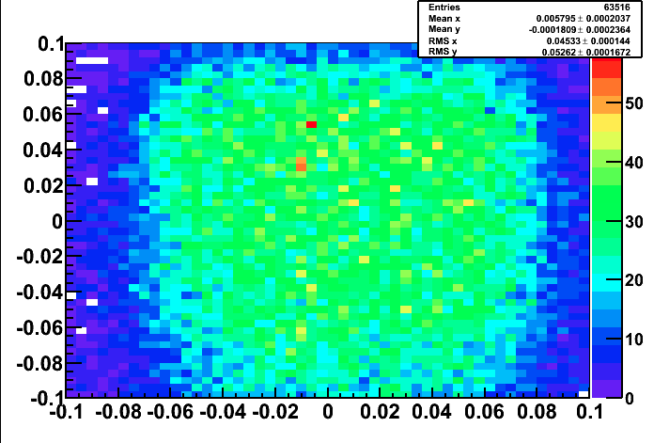
Radius of sensitivity (all pixels)
radius->Draw("dy:dx>>h(50,-0.1,0.1,50,-0.1,0.1)","","COLZ")

Slide 16
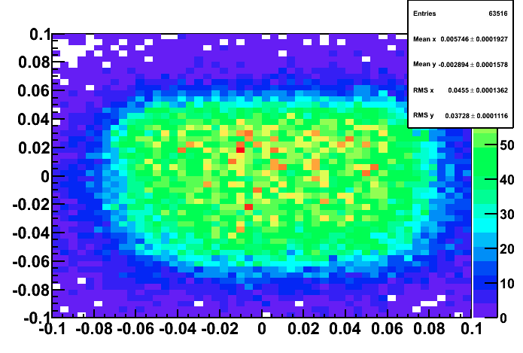
Radius of sensitivity (scaled)
radius->Draw("dy*(500*TMath::Sin(20.27*TMath::Pi()/180)/100)**-1:dx>>h(50,-0.1,0.1,50,-0.1,0.1)","","COLZ")

Slide 17
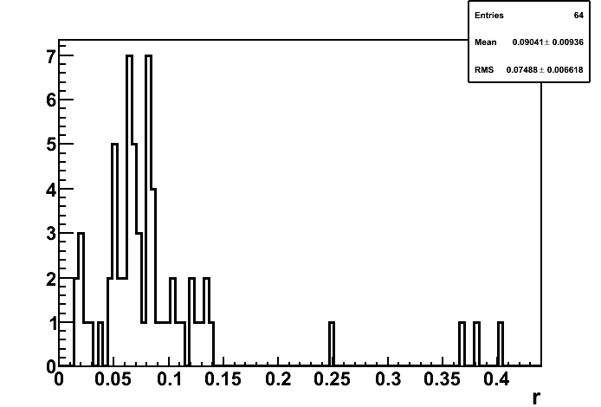
Radius of sensitivity for one pixel

Slide 18
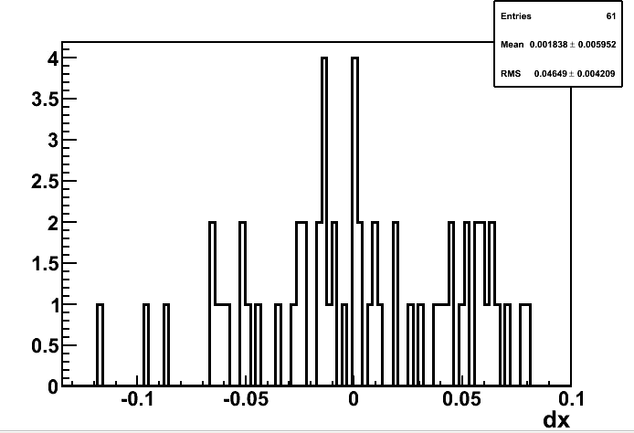
Dx, one pixel

Slide 19
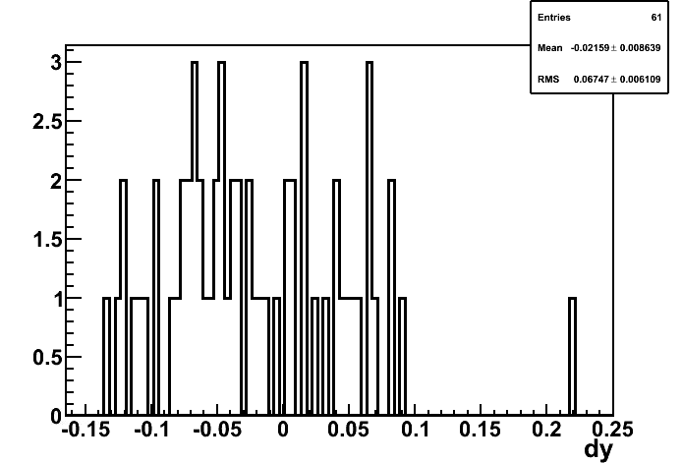
Dy, one pixel

